Slide 1
Face Recognition with Contrastive Convolution
By: C. Han, S. Shan, M. Kan, S. Wu, and X. Chen
Published by: Computer Vision Foundation (2018)
Presented for ECE2390 by: Seth So

Slide 2
Presentation Content
Overview
Methodology
Assessment
Experimental Set-up
Results
Impact
Sources
**All figures taken directly from paper**

Slide 3
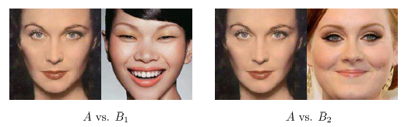
Overview
The current standard for facial recognition brute force compares the features of two faces.
This paper aims to develop a more elegant solution more akin to organic facial detection methods by using dynamic kernelling

Slide 4
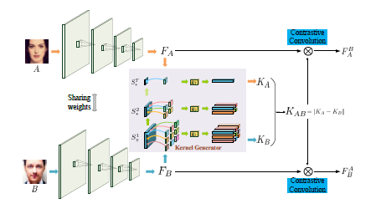
Methodology
Image of Face
Feature Extraction with NN or PCA
Hierarchical Kernel Generation
Dynamic Kernel Formation
Mediated Convolution
Similarity Assessment
Decision
Extra consideration during kernel generation and assessment results in substantially better detection rates.

Slide 5


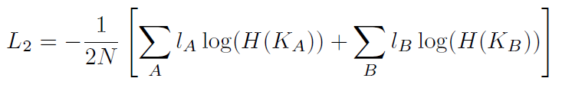
Assessment
2 stage Cross Entropy Loss (CEL) is used to determine if faces are the same:
, with L₁ explicit differences and L₂ implicit differences

Slide 6
Cross Entropy Loss
In Context:
Binary Distribution:
Target: Blue
Non-target: Red
Training Set of Faces
How to classify new point?
Face to classify
Find or define sigmoid probability:
100%
F₁ = P(Blue)
F₂ = P(Red)
Similarity Percentages
0%
Loss = -Log(Probability)*Label:
Max Loss
L
Determination

Slide 7
Assessment
2 stage Cross Entropy Loss (CEL) is used to determine if faces are the same:
, with L₁ explicit differences and L₂ implicit differences

Slide 8
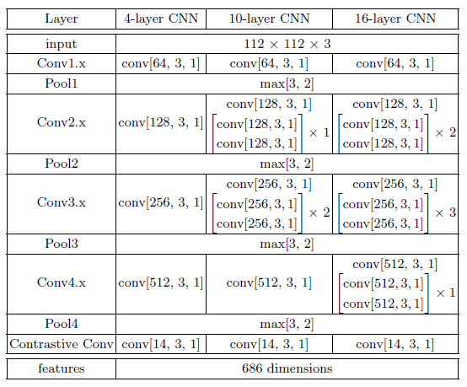
Experimental Set up
Training Set: 128 images from CASIA-Webface (bank of 10,000 people / 500,000 images)
Testing Set 1: 128 images from Labelled Faces in the Wild
Testing Set 2: 128 images from IARPA Janus Benchmark
Preprocessing: Uniform face framing

Slide 9
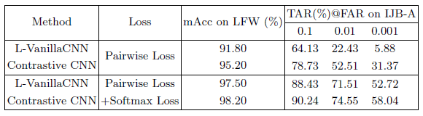
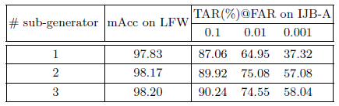
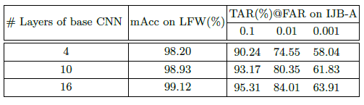
Results 1 - Characterization
Accuracy: Significant increase in accuracy when minimizing FAR (False Positives)
Sub-generator count: More generators improves accuracy at diminishing returns
CNN Layer Count: More network layers improves accuracy at diminishing returns

Slide 10
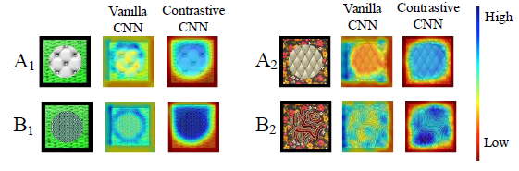
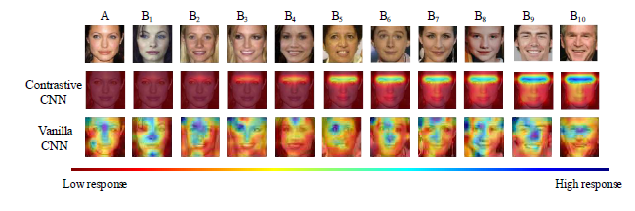
Results 2 – Visual Response Analysis
Visual interpretation is much more organic – similar to how humans would classify differences. Salient features are found then compared with others.
--------
Results visually make more sense to us!

Slide 11
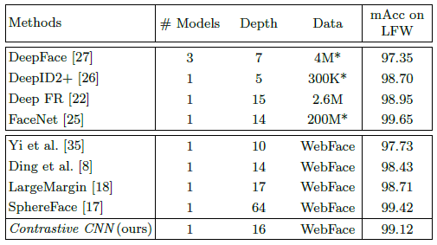
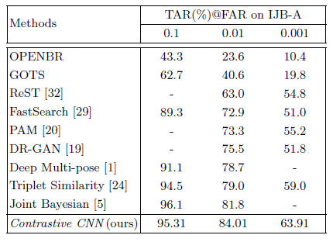
Results 3 - Comparison
Small change in architecture makes standard face recognition competitive with state-of-the-art classifiers
Small change in architecture makes standard face recognition competitive with state-of-the-art classifiers

Slide 12
Impact
Authors were able to drastically improve standard facial recognition by the inclusion of a dynamic kernelling step and stricter loss function. Results are much more similar to human classification at no cost to processing time or memory.
END.

Slide 13
Paper
Link: http://openaccess.thecvf.com/content_ECCV_2018/papers/Chunrui _Han_Face_Recognition_with_ECCV_2018_paper.pdf

